Slide 1
CSEDU Online Research Platform
Redwan Ahmed Rizvee(FH-09)
Mehreen Rahman(SN-61)

Slide 2

Why do we need an online platform of our own ?
What would have been better ?

Slide 3
Motivations
Do we actually find problems to read research papers ?
Is it tough to know the works done before by our seniors ?
Is it easy to collaborate among research groups ?

Slide 4
Here we came to give solution

Slide 5
What Facilities we are providing

Slide 6
Facilities
An online platform to manage thesis submissions/projects/researches.
A platform to know about related works of our department /seniors.
An open platform to collaborate among research groups.

Slide 7
And the main reason ?

Slide 8
Some Demos

Slide 9
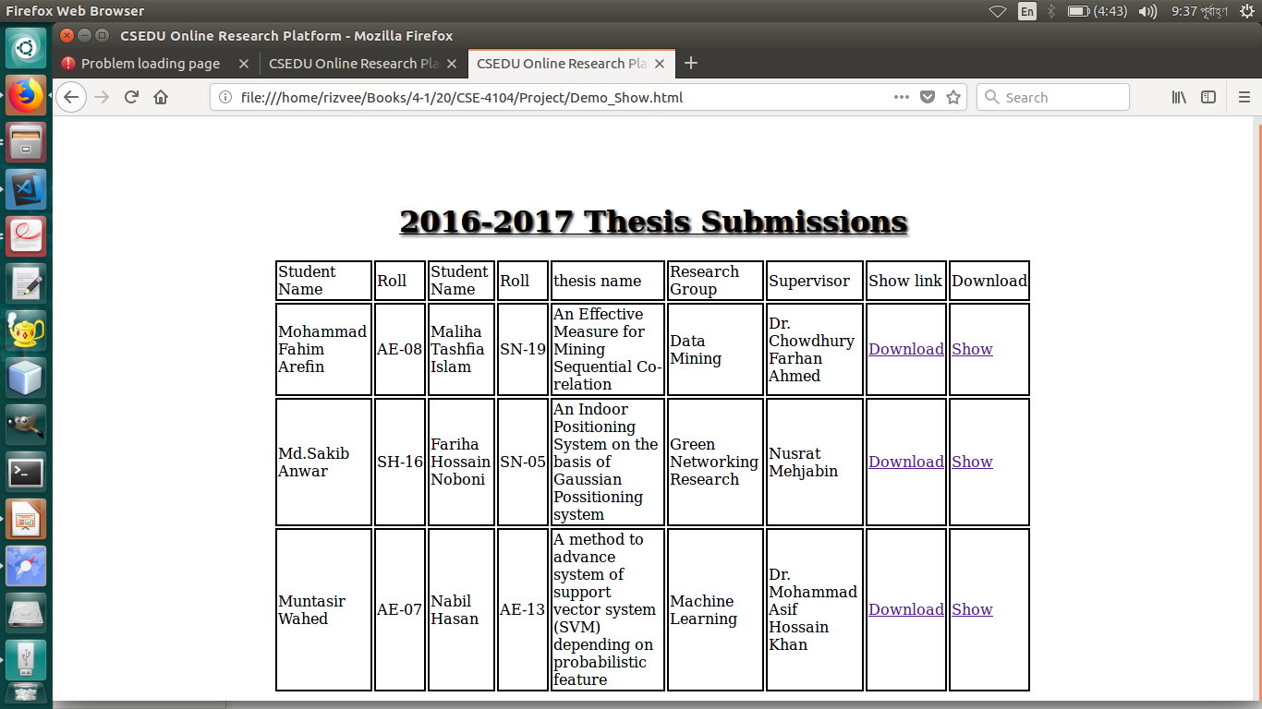

Slide 10
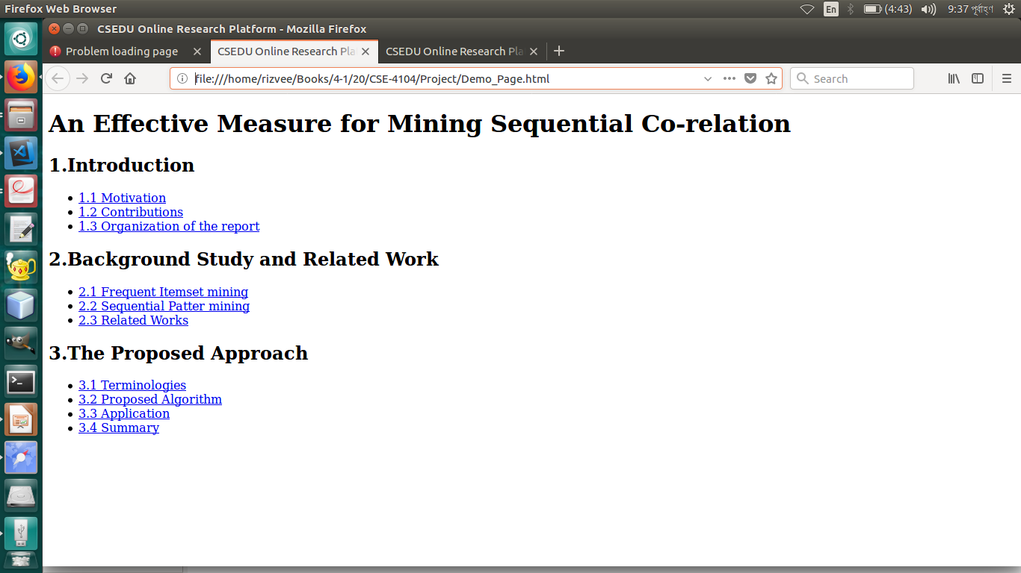
Our Website Provides
An open platform to handle all the thesis papers,

Slide 11
Thank You

